Slide 1
Spring Stereotypes

Slide 2
Spring Framework Stereotypes
• Spring Stereotypes are used to deﬁne Spring Beans in the Spring context • Available Stereotypes - @Component, @Controller, @RestController, @Repository, @Service

Slide 3
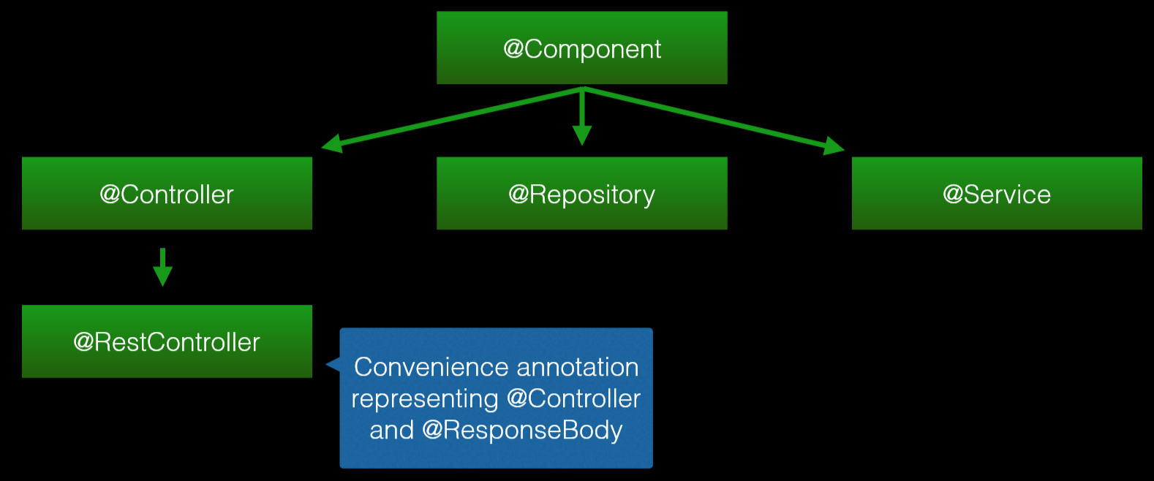
Spring Framework Stereotypes

Slide 4
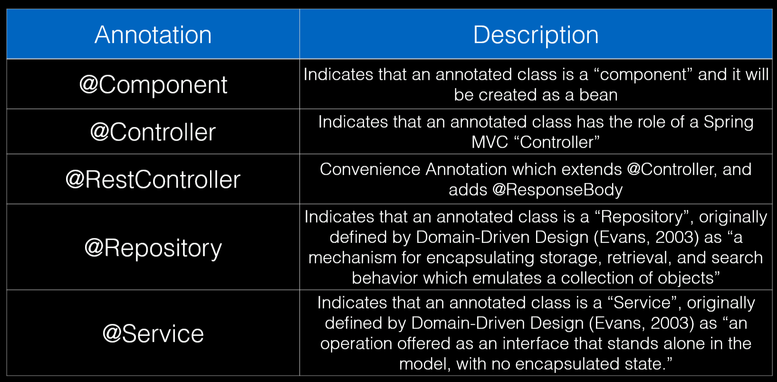
Spring Framework Stereotypes

